Slide 1
Annoucements
Table on stage has been moved.
Speaker wires have been moved underneath the stage.
Tighter focus on camera for Zoom. Hope this helps.
BDA Board meeting this afternoon.
F3 was great last week. Good job!

Slide 2
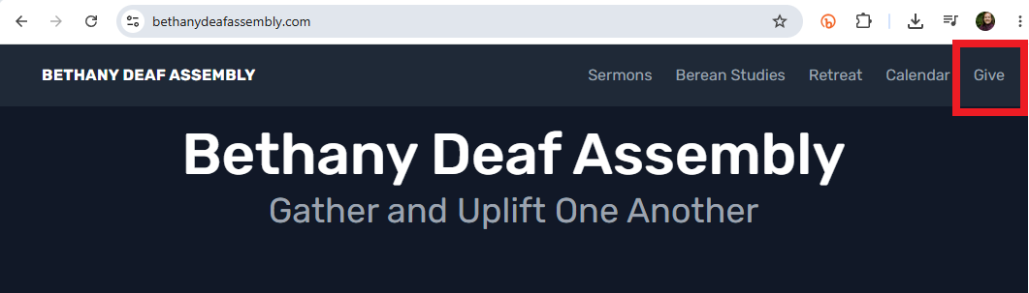
Giving Online – Continue using www.BethanyDeafAssembly.com

Slide 3
General Douglas MacArthur
World War II in the Pacific: He commanded U.S. and Filipino forces in the Philippines at the start of the war. After the Japanese overran the islands in 1942, he was ordered to evacuate to Australia and famously vowed, “I shall return.” He then led Allied forces in the Southwest Pacific, directing the island-hopping campaign and fulfilling that promise by liberating the Philippines in 1944–45. He received the Medal of Honor for his defense of the Philippines.

Slide 4
Matthew 27:45-46 NLT
45 At noon, darkness fell across the whole land until three o’clock.
46 At about three o’clock, Jesus called out with a loud voice, “Eli, Eli, lema sabachthani?” which means “My God, my God, why have you abandoned me?”
This is a quotation from Psalms 22:1

Slide 5
Psalms 22:1-6 NLT
1 For the choir director: A psalm of David, to be sung to the tune “Doe of the Dawn.” My God, my God, why have you abandoned me? Why are you so far away when I groan for help?
2 Every day I call to you, my God, but you do not answer. Every night I lift my voice, but I find no relief.
3 Yet you are holy, enthroned on the praises of Israel.
4 Our ancestors trusted in you, and you rescued them.
5 They cried out to you and were saved. They trusted in you and were never disgraced.
6 But I am a worm and not a man. I am scorned and despised by all!

Slide 6
Psalms 86:5
O Lord, you are so good, so ready to forgive, so full of unfailing love for all who ask for your help.

Slide 7


Slide 8


Slide 9
Find your Balance
If you’re always available, you have no boundaries.
If you have too many boundaries, you are not available.
Always Available Not Available
|-----|-----|-----|-----|-----|-----|-----|-----|-----|-----|-----|-----|
No Boundaries Too many Boundaries

Slide 10
Find your Balance
Proverbs 4:23 NLT
23 Guard your heart above all else, for it determines the course of your life.
Maximize your life in all areas without exhaustion
Notes:
Guard your heart. Guard your ability to maximize your involvement. Maximize your life without exhaustion. Are you listening to same stories over and over? Are you stuck? Are you going in circles?

Slide 11
Find your Balance
Matthew 5:37 NLT
37 Just say a simple, ‘Yes, I will,’ or ‘No, I won’t.’ Anything beyond this is from the evil one.
Are you available? Yes or no. Keep it simple.
Be flexible if you can.

Slide 12
Find your Balance
Mark 1:35-39 NLT
35 Before daybreak the next morning, Jesus got up and went out to an isolated place to pray.
36 Later Simon and the others went out to find him.
37 When they found him, they said, “Everyone is looking for you.”
38 But Jesus replied, “We must go on to other towns as well, and I will preach to them, too. That is why I came.”
39 So he traveled throughout the region of Galilee, preaching in the synagogues and casting out demons.
Notes:
Jesus was in Capernaum when He woke up. Afterwards, He went to other towns in Galilee. He didn’t stay until all needs were met. You have to prioritize your life.

Slide 13
Find your Balance
Mark 6:30-32 NLT
30 The apostles returned to Jesus from their ministry tour and told him all they had done and taught.
31 Then Jesus said, “Let’s go off by ourselves to a quiet place and rest awhile.” He said this because there were so many people coming and going that Jesus and his apostles didn’t even have time to eat.
32 So they left by boat for a quiet place, where they could be alone.
Notes:
As you grow in the Lord, more and more people will come to you. As you grow in the Lord, more and more responsibilities will be put on you.

Slide 14
Physical
Mental
Spiritual
Notes:
Physical Health, Mental Health, Spiritual Health. They are all interconnected. They impact each other. If you’re healthy, you can do more. Do you have anxiety? Where does anxiety come from? You have to be proactive with your health.

Slide 15
Dreams
Hobbies
Friends
Physical
Health
Personal
Spiritual
Health
Relatives
Etc.
Family
Work
Mental
Health
Finances

Slide 16
Find your Balance
But… Are you hiding behind your fear?
Do you avoid trying new things?
Notes:
Do you want to continue living with fear? Do you want to continue living below your maximum potential?

Slide 17
Find your Balance
Proverbs 29:25 NLT
25 Fearing people is a dangerous trap, but trusting the LORD means safety.

Slide 18
Find your Balance
Deuteronomy 31:6 NLT
6 So be strong and courageous! Do not be afraid and do not panic before them. For the LORD your God will personally go ahead of you. He will neither fail you nor abandon you.”
Notes:
Last week, Joanna volunteer to run the keyboard. That is new for her. She’s willing to try. Be brave. You have my permission to try. You have my permission to be brave. You have my permission to make mistakes. You have my permission to have fun. You have my permission.

Slide 19
Find your Balance
Psalms 27:1 NLT
1 A psalm of David. The LORD is my light and my salvation—so why should I be afraid? The LORD is my fortress, protecting me from danger, so why should I tremble?

Slide 20
Find your Balance
Psalms 27:1 NLT
1 A psalm of David. The LORD is my light and my salvation—so why should I be afraid? The LORD is my fortress, protecting me from danger, so why should I tremble?

Slide 21
Find your Balance
Romans 8:14-15 ESV
14 For all who are led by the Spirit of God are sons of God.
15 For you did not receive the spirit of slavery to fall back into fear, but you have received the Spirit of adoption as sons, by whom we cry, “Abba, Father.”
Notes:
If your answer is, “I don’t know how”, “I’m afraid to make a mistake”, “I’m afraid of what other people will think”. “I’m afraid”. Overcome. You can overcome.

Slide 22
Find your Balance
John 14:27 NLT
27 “I am leaving you with a gift—peace of mind and heart. And the peace I give is a gift the world cannot give. So don’t be troubled or afraid.
Notes:
Do you feel the peace? Do you feel the peace in your mind, in your heart, with no fear of other people? Nancy didn’t raise her hands for worship. Now, she does. That’s what we need. More fearless. Raise your hands! Be fearless!

Slide 23
Find your Balance
Hebrews 13:6 NLT
6 So we can say with confidence, “The LORD is my helper, so I will have no fear. What can mere people do to me?”
Notes:
Listen to people who are encouraging you, not people who criticize and put you down.

Slide 24
Prayer

