Slide 1
Annoucements
Calendar
F3 – Sign up
Volunteers – Judging for ASL Contest

Slide 2
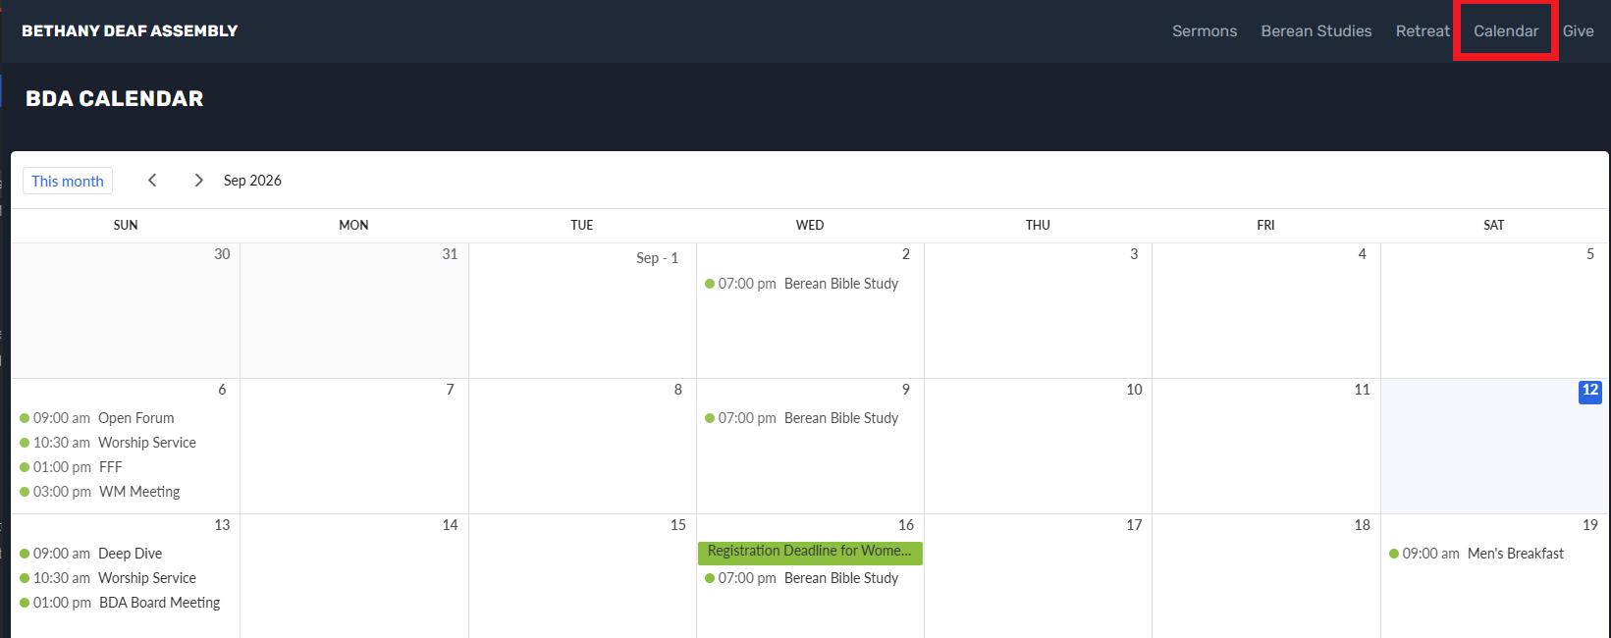
Calendar has been updated with a different format

Slide 3
Genesis 3:1-6 NLT
1 The serpent was the shrewdest of all the wild animals the LORD God had made. One day he asked the woman, “Did God really say you must not eat the fruit from any of the trees in the garden?”
2 “Of course we may eat fruit from the trees in the garden,” the woman replied.
3 “It’s only the fruit from the tree in the middle of the garden that we are not allowed to eat. God said, ‘You must not eat it or even touch it; if you do, you will die.’”
4 “You won’t die!” the serpent replied to the woman.
5 “God knows that your eyes will be opened as soon as you eat it, and you will be like God, knowing both good and evil.”
6 The woman was convinced. She saw that the tree was beautiful and its fruit looked delicious, and she wanted the wisdom it would give her. So she took some of the fruit and ate it. Then she gave some to her husband, who was with her, and he ate it, too.

Slide 4
Passive

Slide 5
Passive
Or
Servant Leadership

Slide 6
Servant Leadership
Be a Servant-Leader for your wife
        Sacrificial Love
Husbands are commanded to love their wives “as Christ loved the church and gave himself up for her” to sanctify, cherish and love her.
Initiate, be first, take out the garbage, help her get ready, help her with her spiritual growth.
Your wife is more important than football.

Slide 7
Servant Leadership
Be a Servant-Leader for your wife
        Sacrificial Love
        Your leadership is gentle.
        Your leadership is not harsh, strict, bitterness or dominance.
        Honor your wife. Open the doors for her. Make her laugh.
        What are her strengths? What does she need? What does she want? What are her dreams? What are her hopes?

Slide 8
Servant Leadership
Be a Servant-Leader for your wife
        Sacrificial Love
        Leadership is a responsibility, not a privilege.
        Make decisions with her. She’s your #1 advisor. Listen to her wisdom.
        She is a child of God. She is co-heir in Christ.
        Shared governance instead of chain of command.

Slide 9
Servant Leadership
Be a Servant-Leader for your wife
        Sacrificial Love
        You and your wife are different. This is God’s design.
        She is different from you. Respect the differences. Honor the differences.
        Resolve conflicts with wisdom and gentleness.
        Avoid “I told you so”. Embrace “We’re on the same side”.

Slide 10
Servant Leadership
Be a Servant-Leader for your wife
        Sacrificial Love
        While love is a feeling, love is also an ongoing choice to nourish, cherish and put your wife first.
        Be present, verbally affirm her, her warmth is more important than yours.

Slide 11
Servant Leadership
Be a Servant-Leader for your wife
        Sacrificial Strength
        Use your strength for service and protection.
        Your strength is not for control or command.
        Humility is a strength. Sacrifice is a strength.

Slide 12
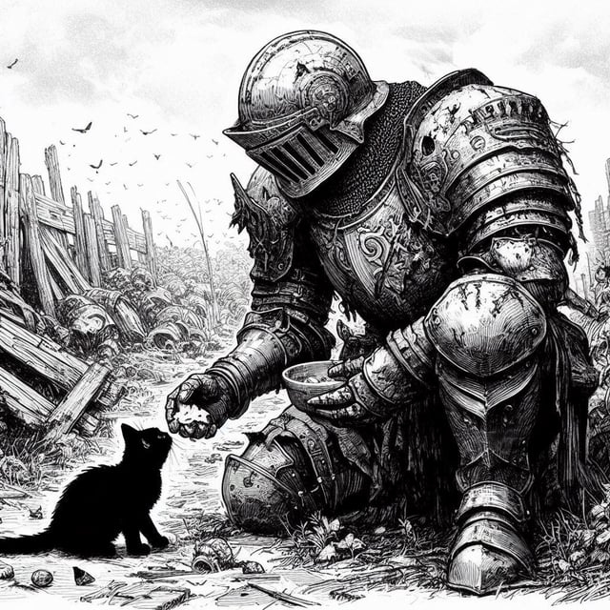

Slide 13
Servant Leadership
Be a Servant-Leader for your wife
        Spiritual Leadership
        Initiate prayer for your wife and for your children.
        Let them see you study scripture.
        Let them see you pray.
        Let them see you be fearless with your faith.

Slide 14
Servant Leadership
Be a Servant-Leader for your wife
        Be strong in all areas
        Be mentally strong. Feed your brain.
        Be physically strong. Get fit.
        Be spiritually strong. Study scriptures. Go beyond “daily bread”. Go deeper.

Slide 15
Servant Leadership
Be a Servant-Leader for your wife
        Study
        Ephesians 5:22-33 Colossians 3:18-19
        1 Peter 3:7 1 Corinthians 11:3
        Genesis 2:18-24 Mark 10:42-45
        John 13 Proverbs 31:28

Slide 16
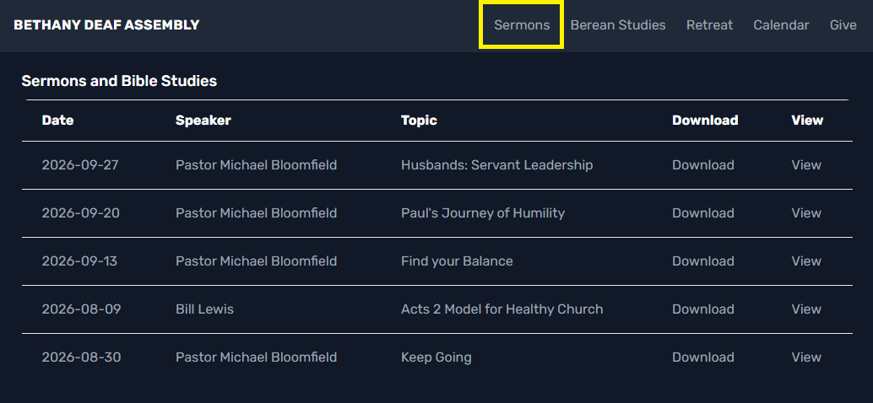

Slide 17
Prayer

